Slide 1
SWASTH
TEAM 3 DAMG 6210 PROJECT
TEAM MEMBERS:
VAISHNAVI PATEL 002242426
SAMPURNA 002831804
SHIVPRIYA MANE 002850626

Slide 2
Problem Statement
Our SQL-integrated Health Fitness Tracker aims to establish a centralized database system, ensuring seamless storage and retrieval of diverse health metrics. By unifying this data, our platform empowers users with efficient tracking, insightful analysis, and informed decision-making for enhanced health management.

Slide 3
Aim
Swasth, a health and fitness app using Oracle, focuses on a robust database structure for tracking individual health metrics like body composition, sleep, and exercises. It offers insights on health status, workout performance, and sleep quality. Users log in to access features based on roles (admin or regular). Regular users monitor personal details, body metrics, sleep, and exercises. Admins manage users, add new data, and perform advanced searches. Data security and privacy are paramount, ensuring a user-friendly, efficient health monitoring platform.

Slide 4
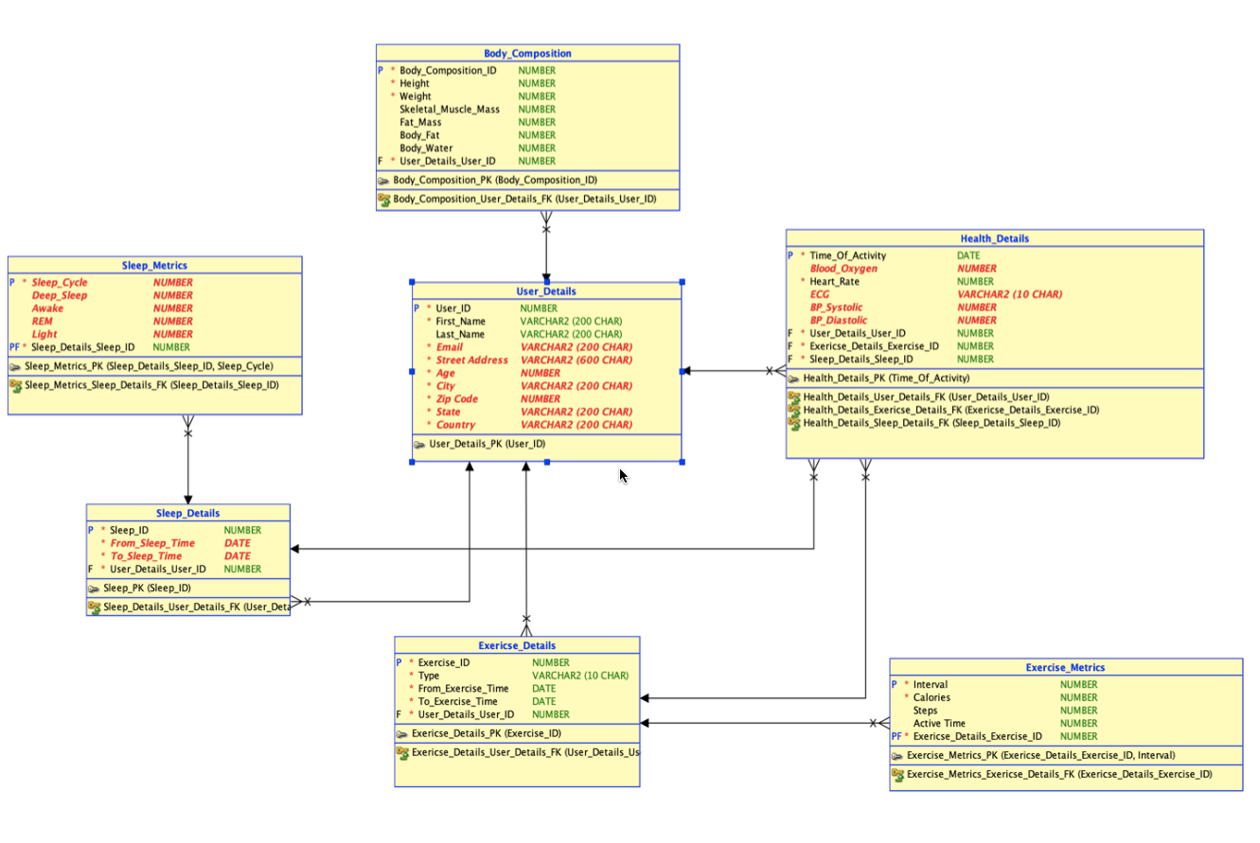
ER Diagram

Slide 5
Contributions
SAMPURNA - Grants, Stored Procedures, User Roles and Views
SHIVPRIYA MANE- Insert queries, Functions and Reports
VAISHNAVI PATEL- Tables, Triggers and Packages

Slide 6
Github Link
https://github.com/sampurng/Swasth
THANK YOU

